Slide 1


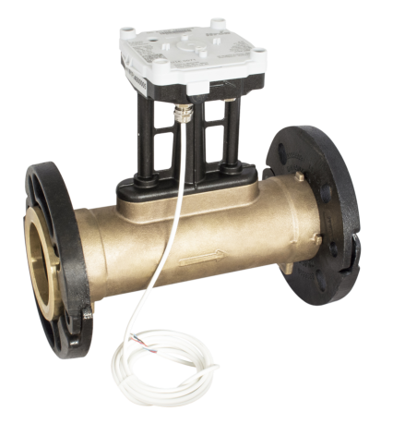
ITRON Thermal Energy
Axonic – Ultrasonic-Flowmeter
DN65-150
©2016 ITRON CONFIDENTIAL PROPRIETARY
Date 00, 0000
Notes:
THIS COVER PAGE OFFERS THE OPTION TO ADD IMAGERY

Slide 2

Axonic – What is Axonic?
What is Axonic ?
Axonic is an ultrasonic static flow meter for heat and cooling applications
Axonic is the essential subassembly of a thermal energy meter.
Axonic serves our customers with outstanding metrological performance.
Axonic comes with unique features that allows Itron positioning in applications that are not accessible from other players.

Slide 3
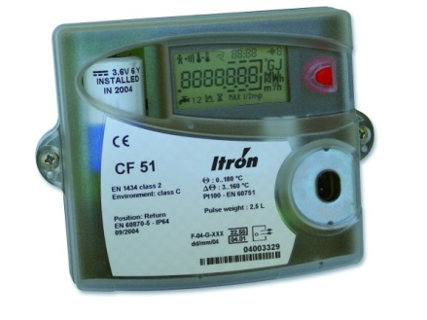

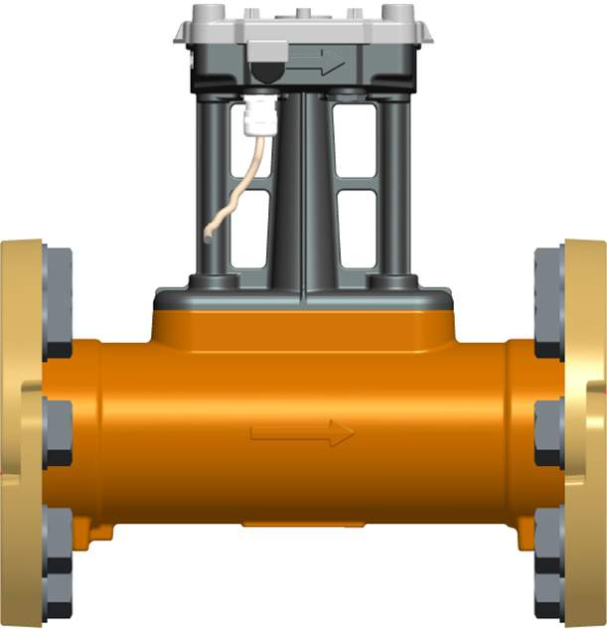

Axonic – What is Axonic?
Axonic is an ultrasonic static flow meter for heat and cooling applications
It‘s a static stand alone flow meter with Interface to calculators
needs to be combined with stand-alone calculator
  CF51, CF55, CF800 (or other brands)
  + Pair of T-sensors
Heat Supply
Heat Return

Slide 4
Axonic – What is Axonic?
Axonic is an ultrasonic static flow meter for heat and cooling applications
It‘s a static stand alone flow meter with Interface to calculators
needs to be combined with stand-alone calculator
  CF51, CF55, CF800 (or other brands)
  + Pair of T-sensors
Cooling Supply
Cooling Return

Slide 5
Axonic – What is Axonic?
What is Axonic ?
Axonic is an ultrasonic static flow meter for heat and cooling applications
Axonic is the essential subassembly of a thermal energy meter.
Axonic serves our customers with outstanding metrological performance.
Axonic comes with unique features that allows Itron positioning in applications that are not accessible from other players.

Slide 6

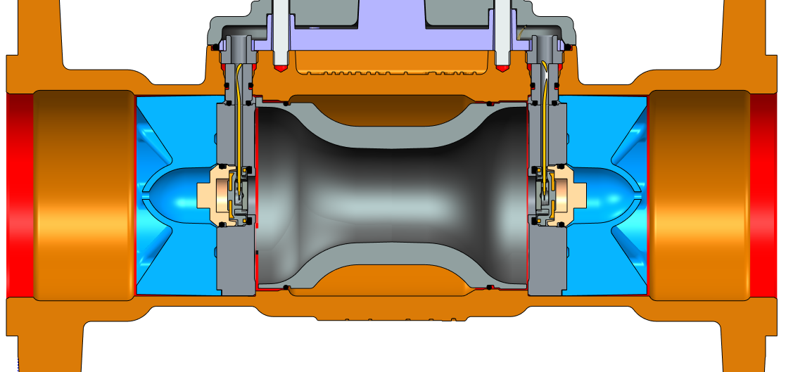
Axonic – What is Axonic?
Axonic is the essential subassembly of a thermal energy meter.
The medium is challenging (magnetit, calcium….)
Networks operates 24h a day, 365 days a year (= permanent flow)
Ultrasonic is the best technology to survive (no wearing, no magnets)!
FLOW
Velocity: V
Acoustic wave velocity: c+V
Acoustic wave velocity: c-V
Time of flight:
With the flow: t1 = d / (c+V)
Against flow: t2 = d / (c-V)
Q = K.Δt.(Σt)⁻²
d

Slide 7
Axonic – What is Axonic?
What is Axonic ?
Axonic is an ultrasonic static flow meter for heat and cooling applications
Axonic is the essential subassembly of a thermal energy meter.
Axonic serves our customers with outstanding metrological performance.
Axonic comes with unique features that allows Itron positioning in applications that are not accessible from other players.

Slide 8

Axonic – Metrologic Performance
Axonic serves our customers with outstanding metrological performance.
Dynamic range up to R400H (standard calibration R250HV)
Example qp25m³/h (DN65) :
Woltman R50
qi 1000 L/h
qs 30m³/h
Ultrasonic R100
qi 250 L/h
qp 25m³/h qs 50m³/h
Axonic R250
qi 100 L/h
qp 25m³/h / qs 50m³/h
Axonic R400
qi 63 L/h
qp 25m³/h / qs 50m³/h
Flow rate [m³/h]
R400 = Unique in the market
qi
qp
qs

Slide 9
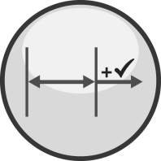
Axonic – Metrologic Performance
Axonic serves our customers with outstanding metrological performance.
Axonic measures also when exceeding qmax
Normal flow indication up to qmax
(pulse output equivalent to flow rate)
q > qmax (1,1x qs):
warning message
pulse output remains equivalent to 1,1qs
limited billing losses.
qc
qi
qp
qs
qmax
Flow rate

Slide 10
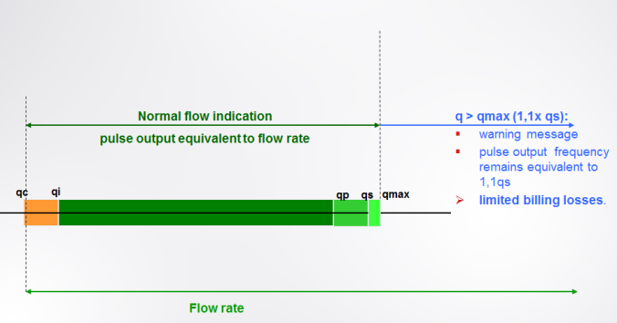
Axonic – What is Axonic?
Axonic serves our customers with outstanding metrological performance.
Axonic measures also when exceeding qmax

Slide 11
Axonic – Metrologic Performance
Axonic serves our customers with outstanding metrological performance.
Accuracy class 2:
  Acceptance criteria: ± 2% (upper flow)
  Typical metrology expected to stay within ±1%!
Accuracy channel
EN1434 class 2

Slide 12

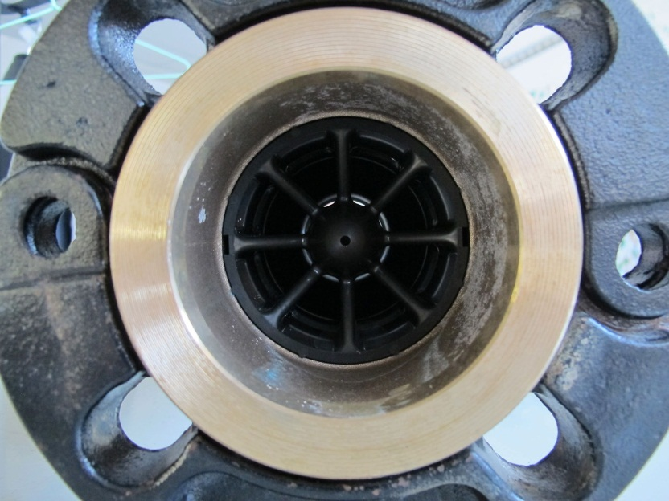
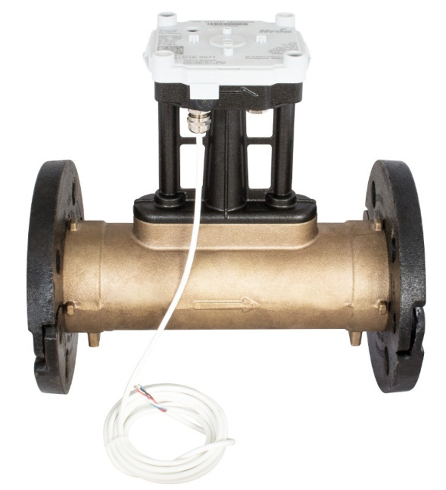
Axonic – Metrologic Performance
Axonic serves our customers with outstanding metrological performance.
Fully concentric design
  flow sensivity class U0D0
  no need for straight length = smallest installation space!
All positions allowed - even diagonal and upside down!

Slide 13
Axonic – What is Axonic?
What is Axonic ?
Axonic is an ultrasonic static flow meter for heat and cooling applications
Axonic is the essential subassembly of a thermal energy meter.
Axonic serves our customers with outstanding metrological performance.
Axonic comes with unique features that allows Itron positioning in applications that are not accessible from other players.

Slide 14
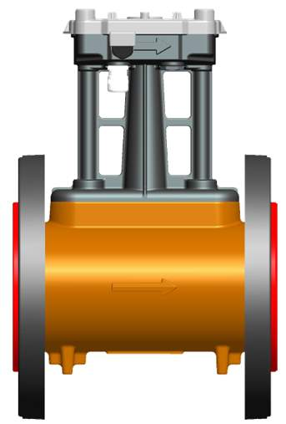
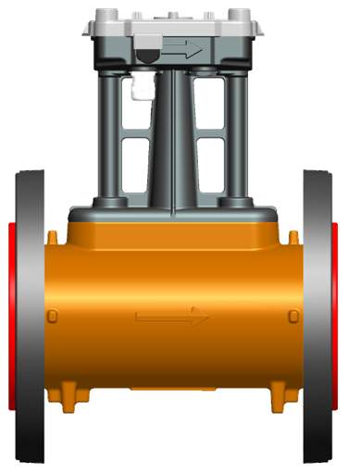
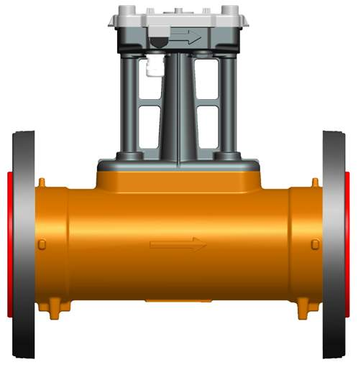
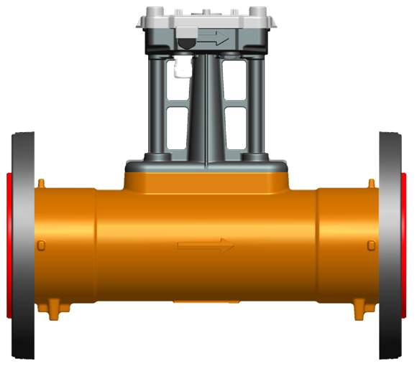
Axonic – Various Sizes
Axonic comes with unique features
Various choice of lengths:
  standard length if standard length requested
  various special sizes for replacement market and new, if possible!
  example DN80 qp40
L = 200mm
Replacement market
Mechanical Woltman
Market: France
+All?
L = 225mm
Replacement market
Mechanical Woltman
Market: Germany
+ All?
L = 300mm
replacement and new Woltman and Ultrasonic
Market: All
L = 350mm
replacement and new
Woltman and Ultrasonic
Market: France
+All?

Slide 15
Axonic – Various Sizes
Axonic comes with unique features
  Body type (DN, length, PN)
DN | QP | Length [mm] | PN [bar]
65 | 25 | 200 | 16
 |  | 300 | 16
 |  |  | 25
 |  |  | 40
80 | 40 | 200 | 16
 |  | 225 | 16
 |  | 300 | 16
 |  |  | 25
 |  | 350 | 16
 |  |  | 40
100 | 60 | 250 | 16
 |  | 360 | 16
 |  |  | 25
 |  | 400 | 16
 |  |  | 40
125 | 100 | 250 | 16
150 | 150 | 300 | 16
 |  |  | 40
 |  | 500 | 16
 |  |  | 25
Flanges PN16/25: EN 1092-2 97 tb 5+9 interface Type B (mobile and dismountable flanges)
Flanges PN40: EN 1092-1 97 tb 6+15 interface Type E (fixed flanges)

Slide 16
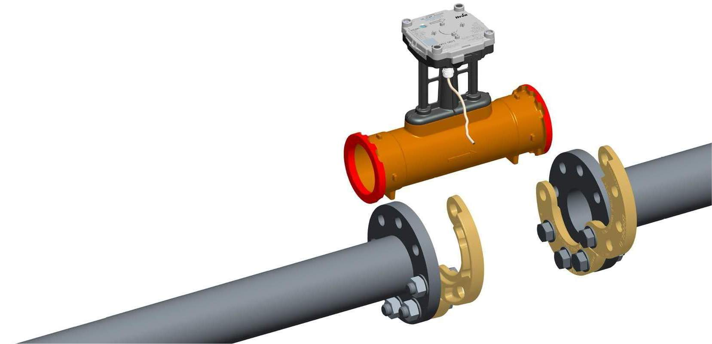
Axonic – Mobile Flanges
Axonic comes with unique features
Mobile Flanges (PN16 & 25 versions):
  proven concept in C&I Water business (Flostar M)
  quick, safe and simple
  installation can easily be done by 1 plumber

Slide 17


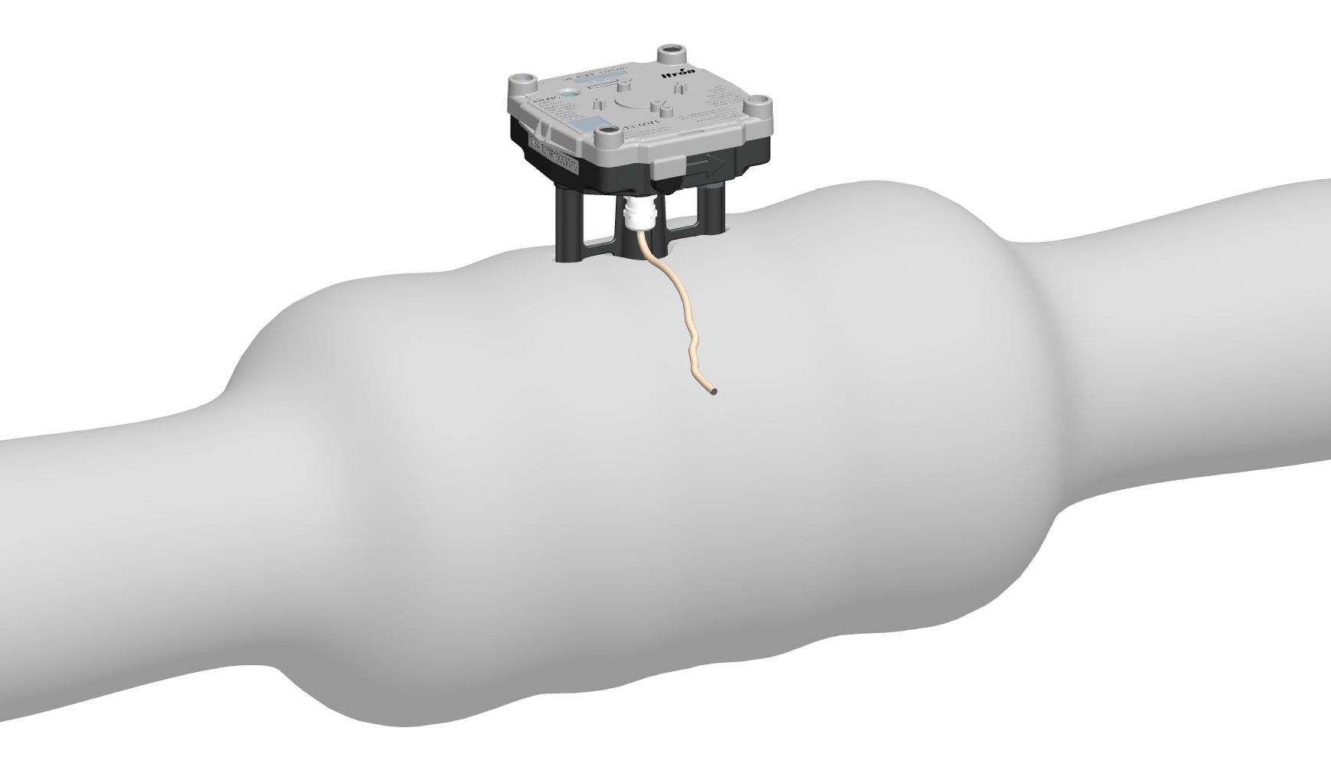
Axonic – Insulation compliant
Axonic comes with unique features
Insulation compliant
  Latest energy efficiency regulations require insulation of meters.
  Due to it’s “long-neck” design Axonic is compliant to full insulation (no overheating of PCB)

Slide 18

Axonic – Double pulse Output
Axonic comes with unique features
Axonic provides a 2nd pulse output (B) (option)
Output A: Energy
(calculators ⇒ M-Bus / RF / GPRS ⇒ Emmsys / MDM)
Output B: Control system
(conncetion to any other device, e.g. for connection to heat control system or to monitor backflow).
Output A: 4-wires:
Bat (+)
GND (-)
µCom communication
pulse-output (+)
Output B: 3-wires:
GND (-)
pulse-output (+)
direction flag
Note: pulse weight B can be different than pulse weight A!

Slide 19

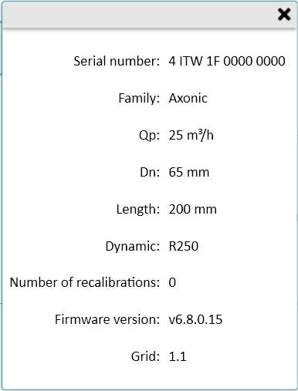
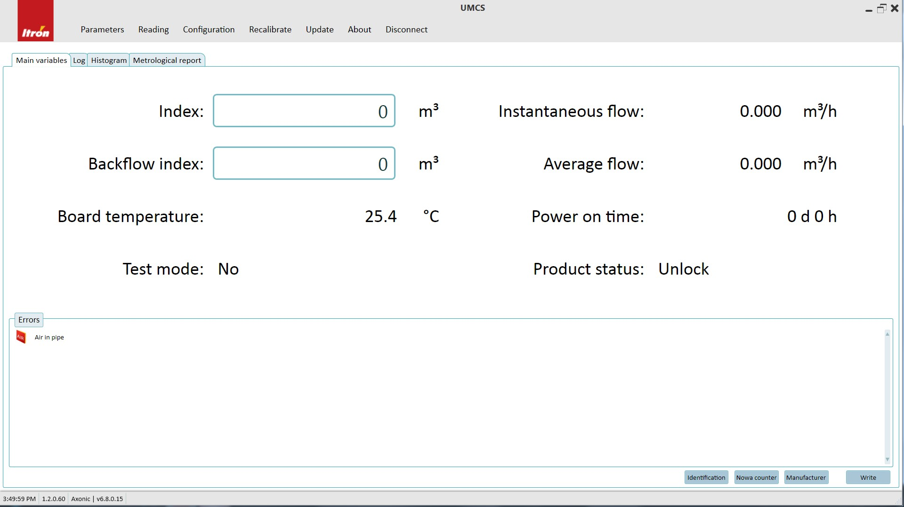
Axonic – UmCS Software
Axonic comes with unique features
UMCS = Ultrasonic Meter Configuration Software
  reading – configuration - re-calibration - flow adjustement
  for RBUs, Distributers and Laboratories
Passport
included

Slide 20
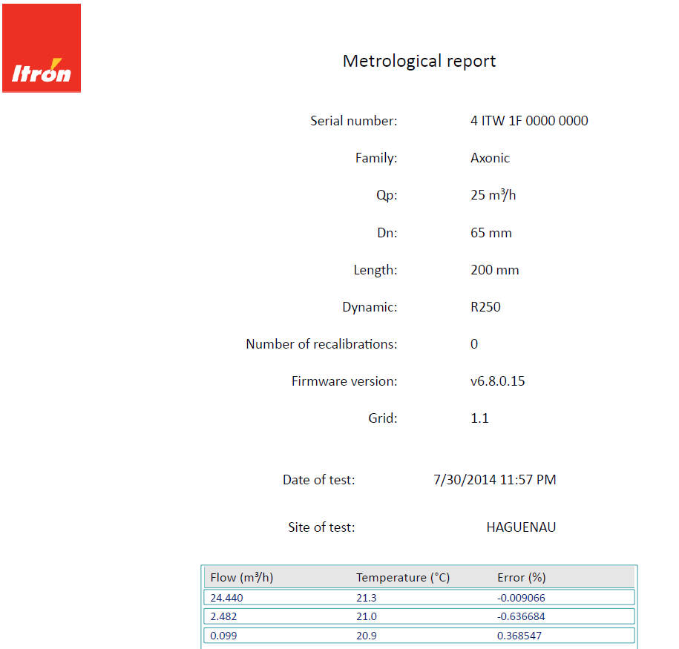
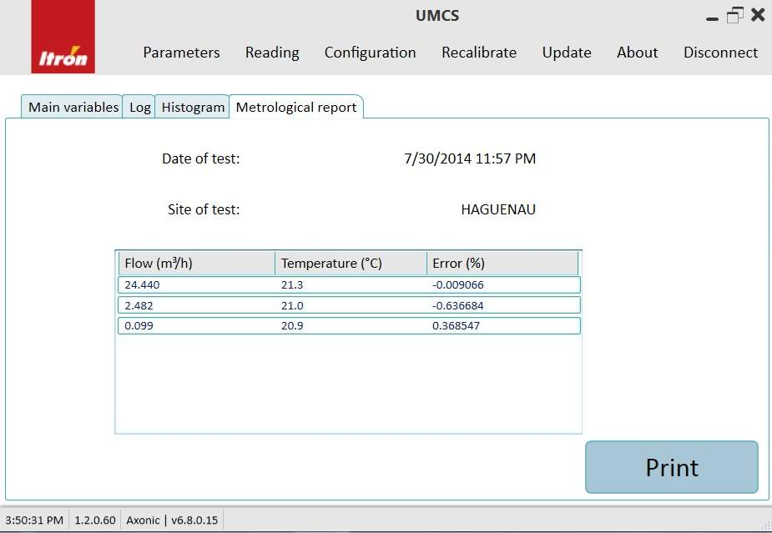
Axonic – UmCS Software
Axonic comes with unique features
Metrological Report Inside the meter!
  read-out with UMCS-Soft
  print-out with UMCS-Soft

Slide 21
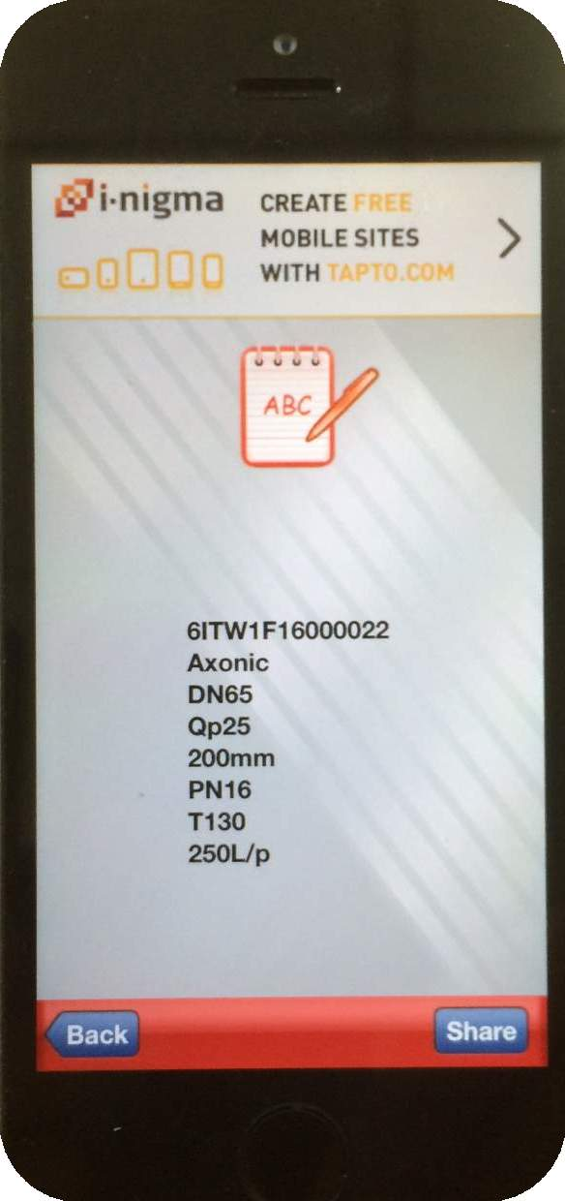
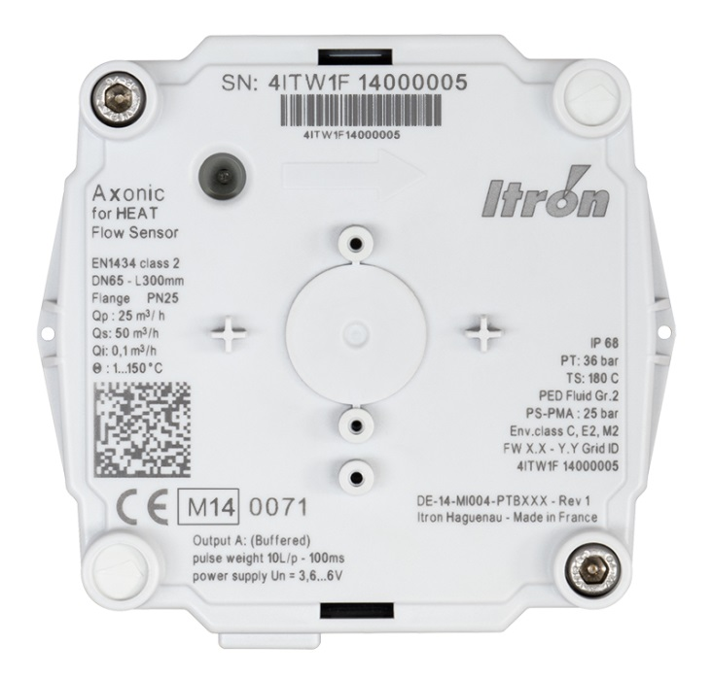
Axonic – On Field tracking
Axonic comes with unique features
2D Barcode contains serial number and meter details
  read-out with any barcode reader
Meter Information coded in
2D Barcode

Slide 22

Axonic – Intelligent Features
Axonic comes with unique features
Axonic is intelligent
  information about status of the network and the meter itself
  status and alarms visible by LED
  communication of alarms to calculator
  vizualisation through AMR systems
    e.g. in Everblu, Emmsys
Status information that can be transmitted:
  flow detected
  air in Pipe
  US Asic Alarm
  low signal amplitude
  max flow alarm
  backflow alarm
  product in test mode

Slide 23
Axonic – What is Axonic?
Axonic comes with unique features
Robust and reliable design:
  Medium temperature range: 1….130° (acc. 150°C)
  Ambient temperature range: -25°C… 60°C
  Environmental class
    EN1434: environmental class C
    MID: environmental class E2 (electromagnetic)
  environmental class M2 (mechanic)
  Body material:
    PN16/ PN25: bronce
    PN40: inox (stainless steel)
  IP68

Slide 24
Axonic – Summary & Highlights
2nd pulse output option
- Energy measurement
- Connect BMS system
Excellent Metrology
- High class 2 accuracy
- Oustanding dynamic range
- Insensitive to flow disturbances
- Reliable and repeatable
Utility revenue protection
- Behaviour above qmax
- Low flow performance
Ease of installation
- Mobile flange design
- No straight length required
- Installation in any position
- Various choice of length
Environmental friendly
- Thermal Insulation compliant
- External power supply
Self-diagnostic intelligence
- Air in Pipe
- Backflow
- Dirty medium…
- Overflow
Robust and Reliable
- Medium 130°C permanent
- High Pressure versions (PN40)
Internal memory
- Passport inside
- Test protocol inside

Slide 25

Axonic Summary
Summary
qp 25 up to qp150
DN65 up to DN150
Accuracy EN1434 Class 2
Environmental class E2, M2 acc. EN1434
Temperature T: 1°C up to 130°C
PN16 / PN25 / PN40
power supply by the calculator (or battery or mains supply using the pulse box)
Data communication (e.g. dirty warning message) in case of use with CF51/55/800
2nd pulse output option
Internal memory
  Passport inside
  Test protocol inside

